Slide 1
E-commerce Orders
DATABASE ANALYSIS

Slide 2
Columns included
Order info
Order_ID
Customer_ID
Product info
Category
Payment_Method
Dates & Status
Order_Date
Delivery_Date
Customer_Name
City
Product
Price
Quantity
Total_Amount
Rating
Order_Status
Delivery_Days

Slide 3
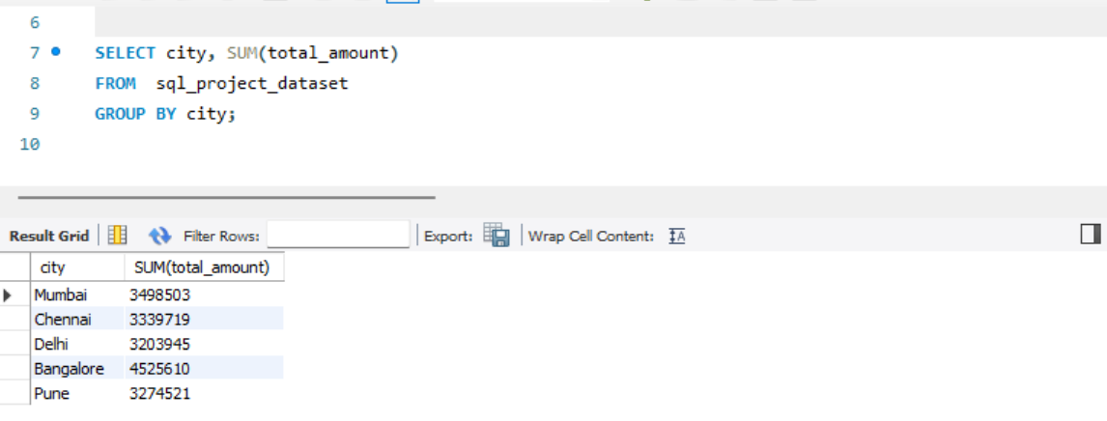
TOTAL SALES BY CITY

Slide 4
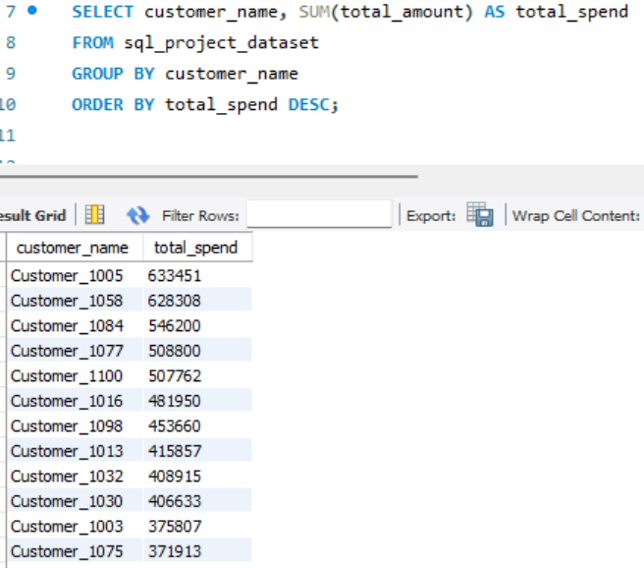
TOP CUSTOMERS

Slide 5
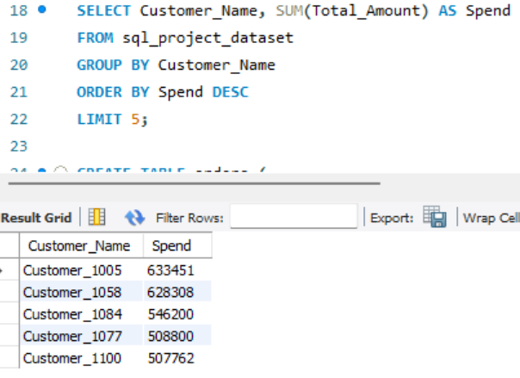
TOP 5 CUSTOMER

Slide 6
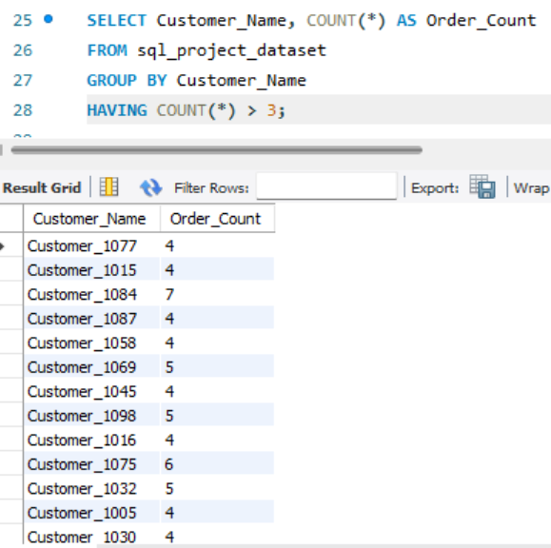
CUSTOMERS MORE THAN 3 ORDERS

Slide 7
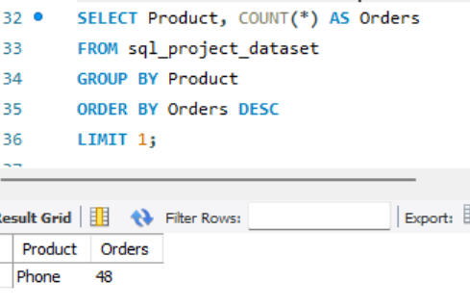
MOST ORDER PRODUCT

Slide 8
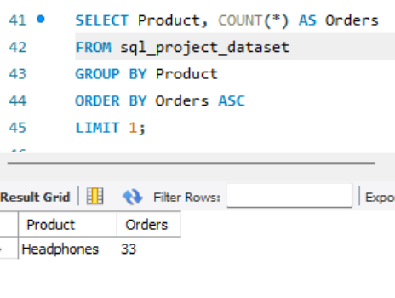
LEAST ORDER PRODUCT

Slide 9
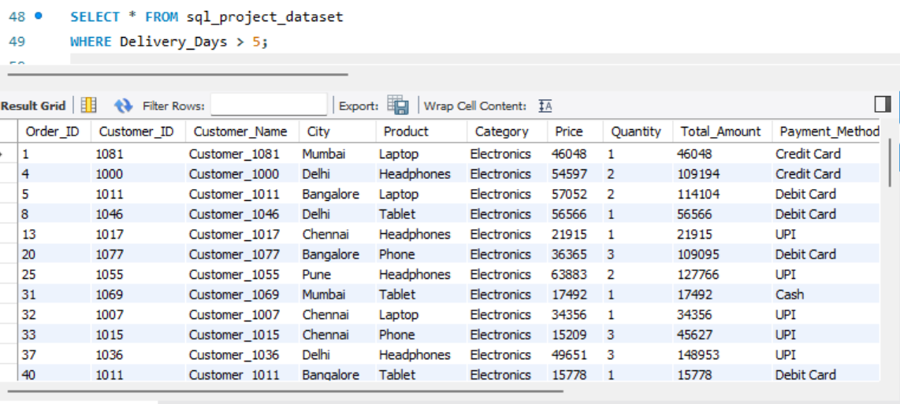
Orders delivered in more than 5 days

Slide 10
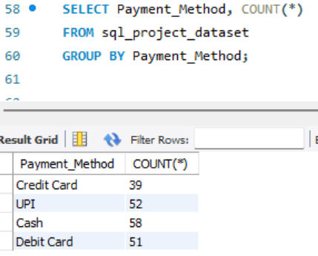
Payment method usage

Slide 11
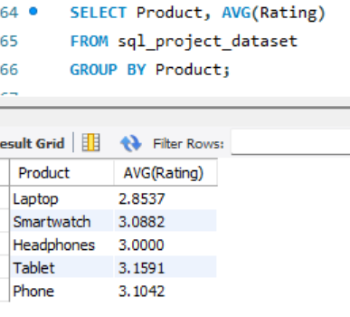
Average rating per product

Slide 12
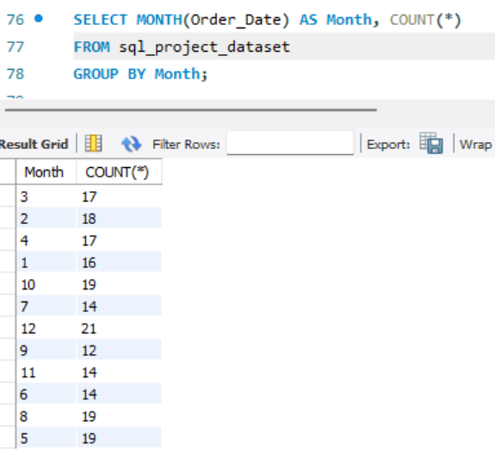
Orders per month

Slide 13
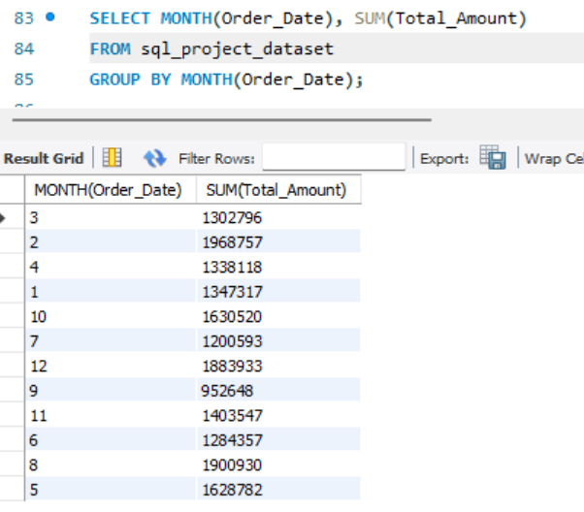
Revenue per month

Slide 14
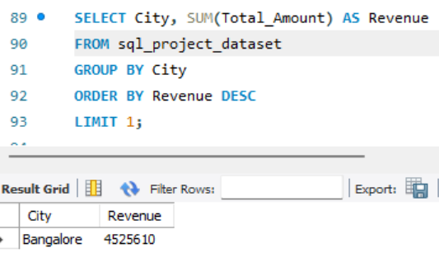
Highest spending city

Slide 15
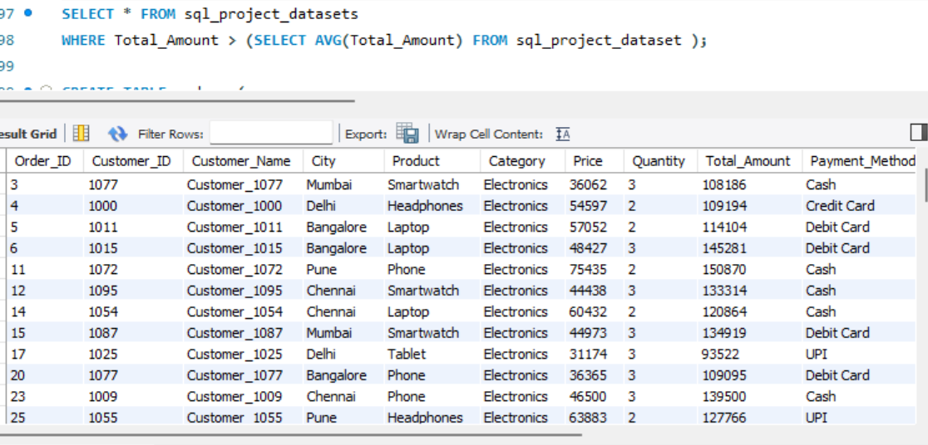
Orders with above average amount

Slide 16
KEY INSIGHTS & SUMMARY
TOP CITY
BANGALORE LEADS WITH ₹45.3L REVENUE – HIGEST AMONG ALL CITIES
MOST ORDERED
PHONE IS THE #1 PRODUCT WITH 48 ORDERS;
HEADPHONES LEAST AT 33
BEST MONTH
DECEMBER HAS THE MOST ORDERS (21);SEPTEMBER THE FEWEST(12)
TOP CUSTOMERS
CUSTOMER _ 1005 IS THE HIGEST SPENDER AT ₹ 6,33,451
PAYMENT
CASH (29%) IS MOST PREFERRED, CREDIT CARDS LEAST USED (19.5%)
RATINGS
TABLET RATED HIGEST (3.16) , LAPTOP NEEDS IMPROVEMENT (2.85)

Slide 17
THANK YOU

